Slide 1

PERSONAL EXPENSE TRACKER
111720102013 - ASWINKUMAR P
111720102014 - CHIRUDEEP B
111720102023 – CHARAN SAI B

Slide 2

CONTENT
01
ABSTRACT
02
TECHNOLOGY USED
03
MODULES USED
04
HARDWARE REQUIREMENTS
05
SOFWARE REQUIREMENTS

Slide 3

06
PREVIOUS MODELS
07
METHODOLGY
08
DATA MODEL
09
REFERENCES

Slide 4
ABSTRACT
Personal Expense Tracker (PET) is a daily expense management software which is specially designed to keeping track of their daily expenditure with an easy and effective way through a computerized system which tends to eliminate manual paper works. This software is very useful for financial management. Users can track their expenses on a daily and monthly basis. They can also check the expenses in a different category from food to clothing. Users can also set a budget so that when they cross the limit they will get notification. We are using python for frontend and backend and SQLite3 for database.

Slide 5
TECHNOLOGY USED
FRONT END:
PYTHON (TKINTER)
BACK END:
PYTHON
DATA BASE:
SQLITE3

Slide 6

MODULES USED
Python module used to design graphical interface.
TKINTER
01
Python module used to use the in-built database.
02
SQLITE3
Python module used to work with date and time.
DATETIME
03
Python module used to work with calendars.
04
TKCALENDAR

Slide 7
HARDWARE REQUIREMENTS
Hard disk with minimum 5 GB empty space
RAM with minimum 2 GB
Processor with Pentium 1 and above
specifications

Slide 8
SOFTWARE REQUIREMENTS
1. OPERATING SYSTEM
Windows XP/Windows
2. LANGUAGE
Python
3. DATABASE
SQLite3
4. CODE EDITOR
Visual Studio Code

Slide 9
PERVIOUS MODEL
In [1], the model works in android which gets the user's income and expense details and stored in a database like SQLite. From that, they are reporting on a monthly and yearly basis. The main drawback is that they are not categorized the different types of expenses of the users.
In [2], the model uses PHP. They created a web application for multiple users, where the user can log in using their user id and password. They can enter their expense details in it. Users can enter their expense details. Then the expense data is presented at the end of a day or a month or a year or periodically by graphs. Here, there is no limitation for the expenses, i.e., any notification for alarm for crossing the limits on a day or a month.

Slide 10
METHODOLOGY
4. SET NOTIFICATION TO CONTROL EXPENSES
3. GET USERS EXPENSES DETAILS ON THE DAILY OR WEEKLY BASIS
1. CREATE USER ACCOUNT
2. GET USERS MONTHLY AND ANNUAL INCOME

Slide 11
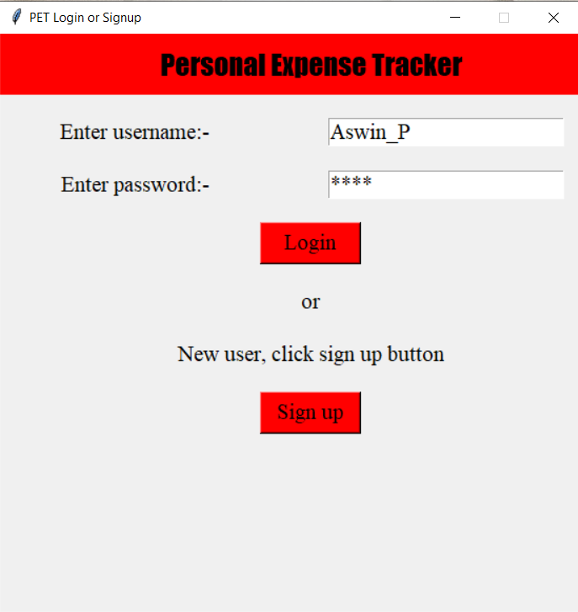
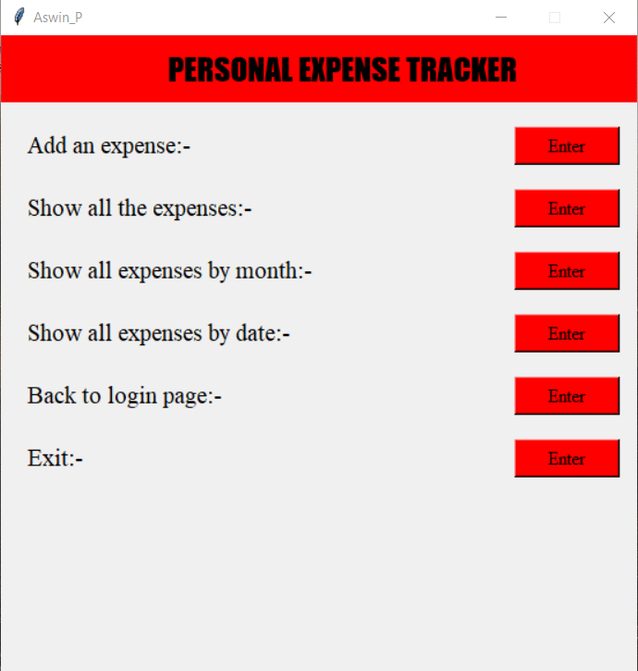
SCREENSHOTS

Slide 12
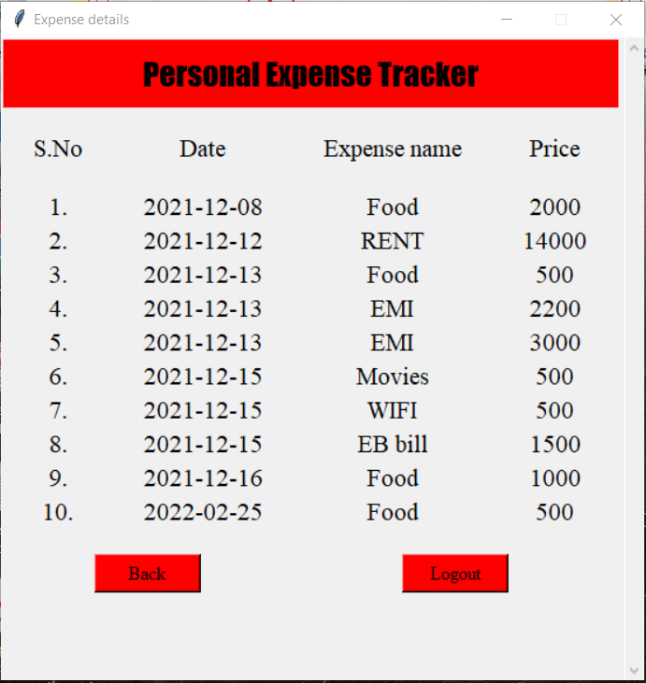
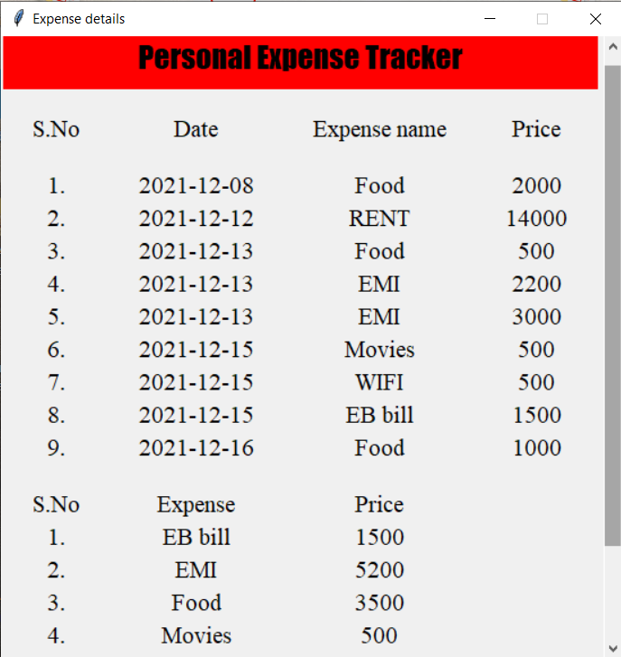
SCREENSHOTS

Slide 13
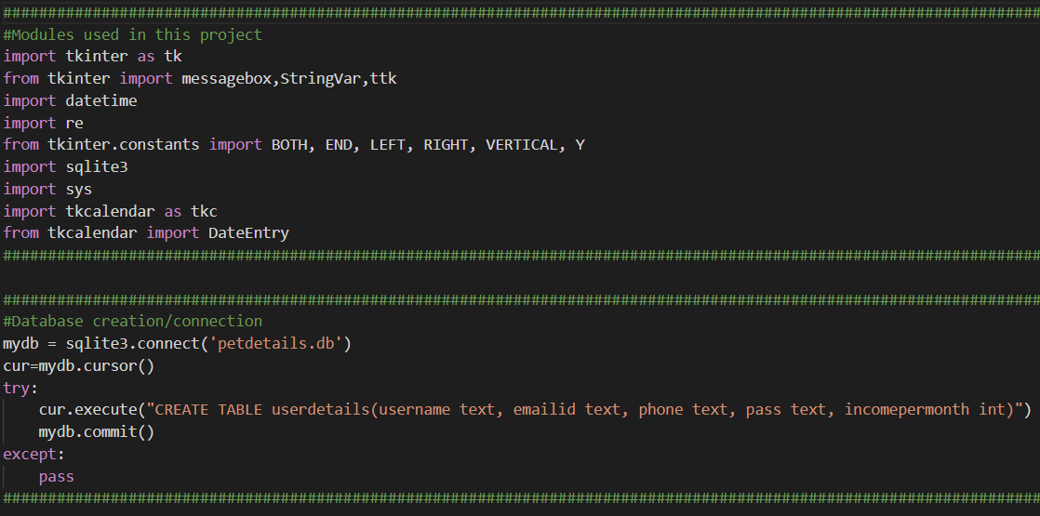
SAMPLE CODE

Slide 14
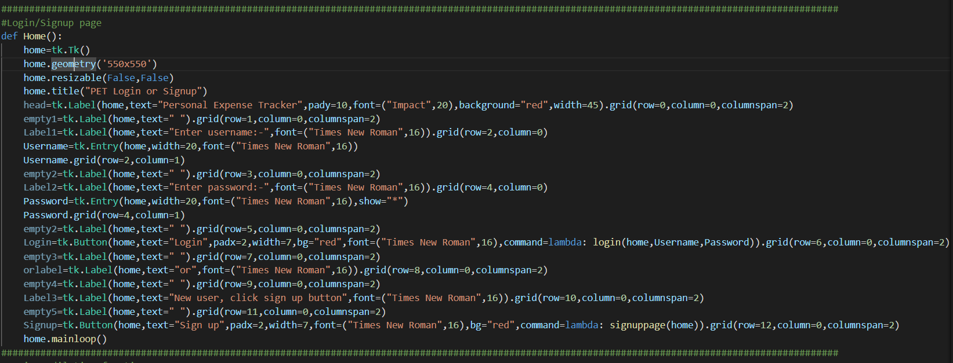
SAMPLE CODE

Slide 15
REFERENCES
[1] Shahed Anzarus Sabab, Sadman Saumik Islam, Md. Jewel Rana, Monir Hossain, “eExpense: A Smart Approach to Track Everyday Expense”, IEEE(2018).
[2] Atiya Kazi, Praphulla S Kherade, Raj S Vilankar, Parag M Sawant, “EXPENSE TRACKER”, Iconic Research and Engineering Journals, Volume: 4 ISSUE: 11, ISSN: 2456-8880 (May 2021).
[3] S Chandini, T Poojitha, D Ranjith, V J Mohammed Akram, M S Vani, V Rajyalakshmi, “Online Income and Expense Tracker”, International Research Journal of Engineering and Technology (IRJET), Volume: 06 Issue: 3, e-ISSN: 2395-0056, p-ISSN: 2395-0072 (March 2019).

Slide 16
THANK YOU

